Slide 1

World Wide Energy Consumption Analysis
Team Members
Batch 474
Tannidi Hemanth
Trinadh Kumar Reddi
Ch Vishwak Ratna

Slide 2
Agenda
The study aims to:
Understand how economic growth impacts energy usage and emissions.
Identify key contributors to global emissions.
Analyze trends over time across different countries.
Evaluate energy efficiency using per capita and ratio-based metrics.
Problem Statement
The objective of this project is to analyze global energy data across multiple countries using SQL to uncover meaningful insights about the relationship between energy consumption, production, emissions, GDP, and population.

Slide 3
PROJECT OVERVIEW
Analyzed global energy data across multiple countries
Focused on:
Energy Consumption & Production
Emissions
GDP
Population
Goal:
Identify trends
Understand economic vs environmental impact

Slide 4
Data Preparation
Imported 6 CSV datasets into MySQL
Created relationships using foreign keys
Ensured:
Consistent country names
Year alignment across tables
No missing joins

Slide 5
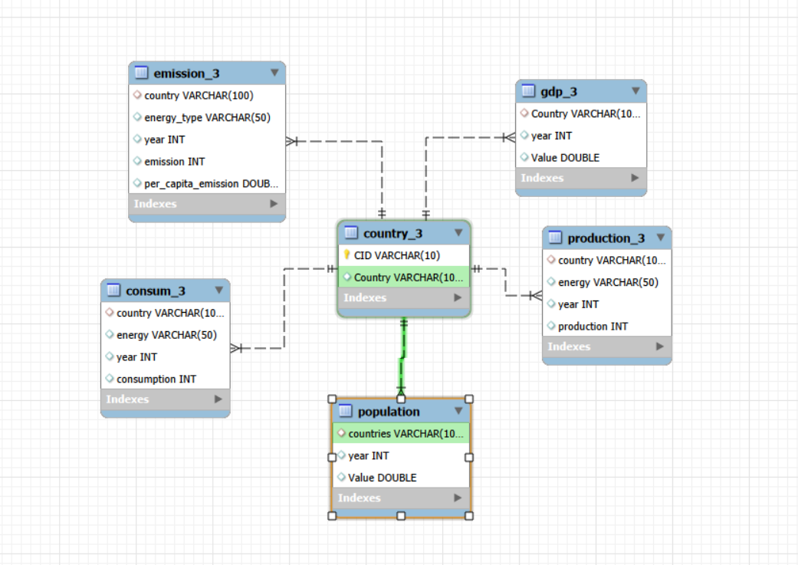
Database Overview
Database Schema:
Country_3 → (many) population
Country_3 → (many) emission_3
Country_3 → (many) population
Country_3) → (many) production
Country_3 → (many) consumption
Country_3 → (many) gdp_3
All Tables were linked using Country and Year.

Slide 6
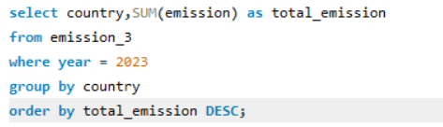
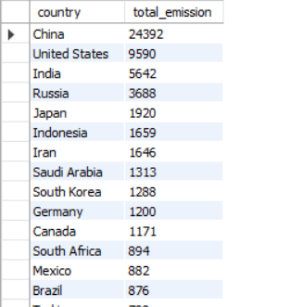
Data Analysis Questions
General & Comparative Analysis
What is the total emission per country for the most recent year available?
Insight:
Most countries have very low per capita emissions (~0.007).
Emissions are relatively uniform across smaller countries,
while larger economies dominate in total emissions
when aggregated.
Higher industrial activity → higher emissions

Slide 7

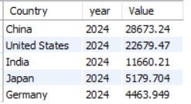
Data Analysis Questions
What are the top 5 countries by GDP in the most recent year?
From Data:
USA, China, India, Vietnam, etc. appear at top
The top GDP countries are dominated by large
economies like the United States, China, and India,
reflecting strong industrial and economic activity.

Slide 8
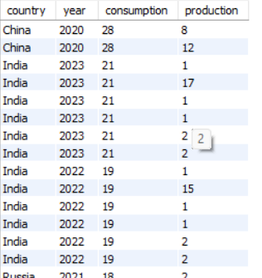
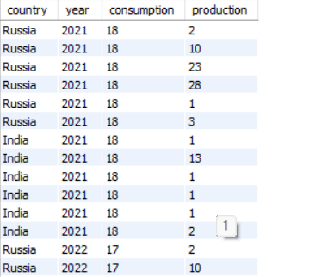
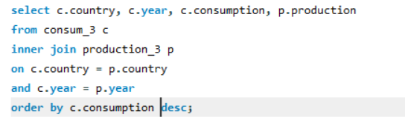
Data Analysis Questions
Compare energy production and consumption by country and year.
Many countries have low production but higher consumption.
Some have balanced or surplus production.
Developed economies tend to have high production and consumption, while smaller or developing
countries rely more on imports.

Slide 9
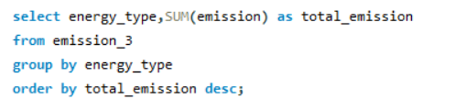
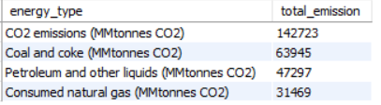
Data Analysis Questions
Which energy types contribute most to emissions across all countries?
CO₂ emissions (Total): ~142,723 , highest among all categories.
Coal & coke: ~63,945
Coal-based energy remains a major source
of emissions due to heavy industrial usage.
Petroleum & liquids: ~47,297
Transportation and fuel consumption significantly
contribute to emissions.
Natural gas: ~31,469
Natural gas is relatively cleaner compared to coal and
petroleum, but still contributes substantially.
Coal and petroleum together contribute more than natural gas,
highlighting the continued reliance on high-emission fossil fuels globally.

Slide 10
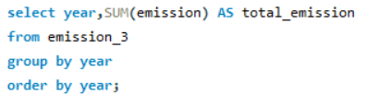
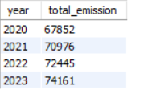
Data Analysis Questions
Trend Analysis Over Time
How have global emissions changed year over year?
Global emissions have shown a consistent upward trend over
the years.
Sharp rise between 2020 – 2021 indicates recovery in
industrial and economic activities post slow-downs.
For the successive years of 2022,2023 emission growth is
stabilizing but still increasing.

Slide 11

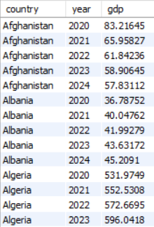

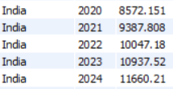
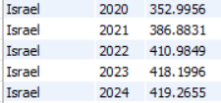
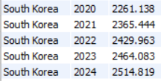
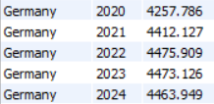
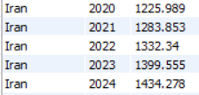
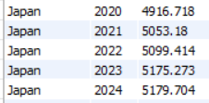
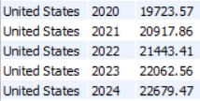
Data Analysis Questions
What is the trend in GDP for each country over the given years?
GDP increases year-over-year for most countries.
Most countries show consistent economic growth,
indicating expanding economies globally.

Slide 12
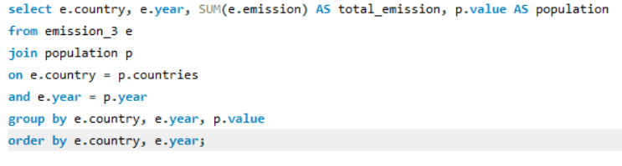
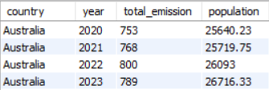
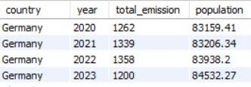
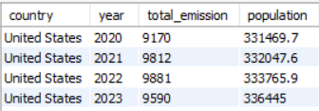
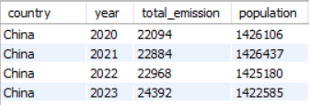
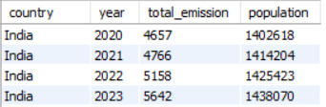
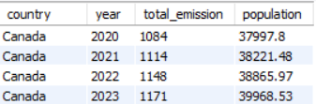
Data Analysis Questions
How has population growth affected total emissions in each country?
Population is steadily increasing in most countries.
Population growth does not directly translate to
higher emissions.
In industrializing countries, emissions tend to rise
with population growth.
The relationship between population and emissions is not
uniform across countries and depends on factors like industrialization, energy usage, and efficiency.

Slide 13
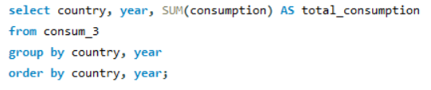
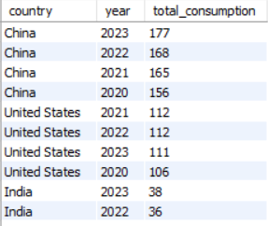
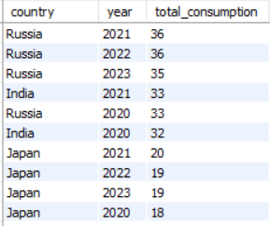
Data Analysis Questions
Has energy consumption increased or decreased over the years for major economies?
Most countries show Year-over-year increase in
consumption.
Large economies like USA, China, India shows
higher and faster growth.
Global energy demand is rising consistently over
time.
Industrial and economic expansion is a key driver
of energy consumption.

Slide 14
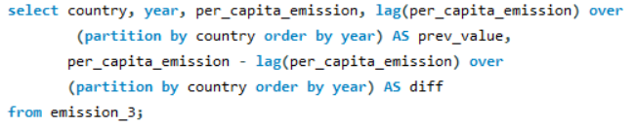
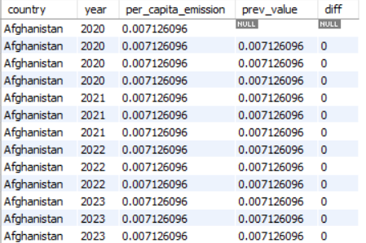
Data Analysis Questions
What is the average yearly change in emissions per capita for each country?
Most countries show minimal change (~0).
Indicates stable emission patterns.
No significant increase or decrease observed.
I used LAG to calculate year-over-year changes and
then averaged those changes to understand long-term
emission trends per country.

Slide 15
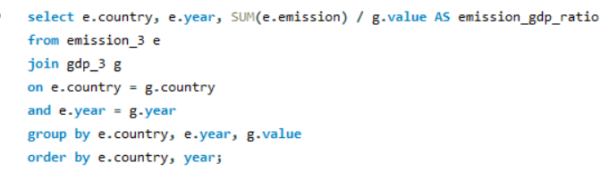






Data Analysis Questions
Ratio & Per Capita Analysis
What is the emission-to-GDP ratio for each country by year?
Countries with lower GDP show higher ratios.
Developing economies generate more
emissions per unit of economic output.
Developing countries: Focus on growth → less efficiency.
Developed countries: Focus on optimization → better efficiency.

Slide 16
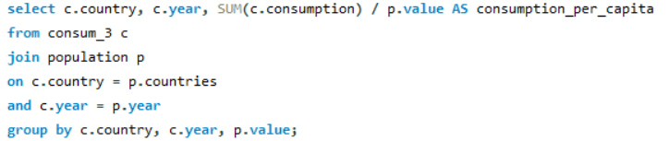
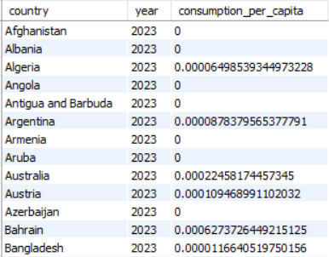
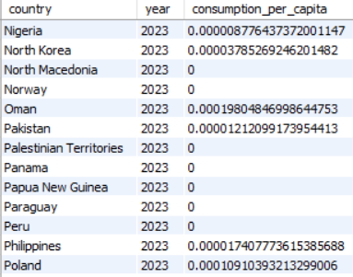
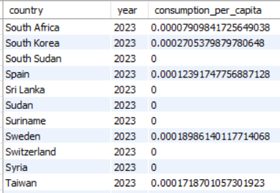
Data Analysis Questions
What is the energy consumption per capita for each country over the last decade?
Higher in developed countries.
Higher living standards and infrastructure lead to
greater energy usage per person.

Slide 17
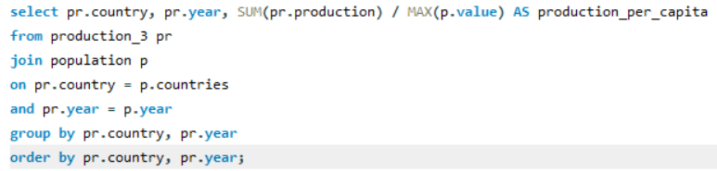
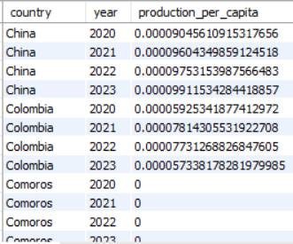
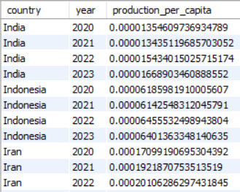
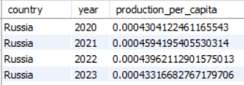

Data Analysis Questions
How does energy production per capita vary across countries?
Energy production per capita measures how much
energy a country produces per person, indicating
resource availability and production capacity.
Energy production capacity is highly uneven across
countries. Countries with natural resources produce
more energy per person.

Slide 18
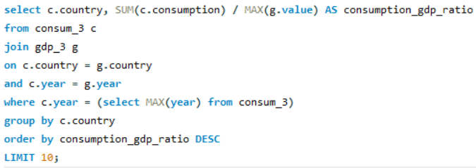
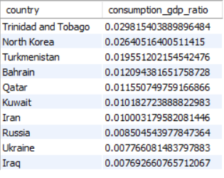
Data Analysis Questions
Which countries have the highest energy consumption relative to GDP?
Countries with high ratio consume more energy
per GDP. These countries are less energy-efficient.
Economic output is not proportional to energy usage.
Better technology and efficiency reduce energy
intensity.
Consumption-to-GDP ratio reflects how “energy intensive”
an economy is.
Countries with higher consumption-to-GDP ratios are less
efficient in converting energy into economic output.
This metric is crucial because it normalizes energy
consumption against economic output, providing a more
meaningful comparison across countries.

Slide 19
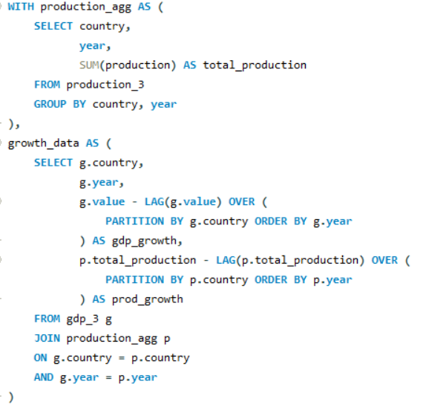
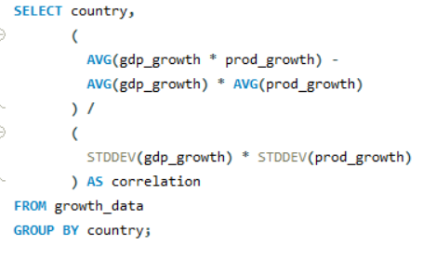
Data Analysis Questions
What is the correlation between GDP growth and energy production growth?

Slide 20
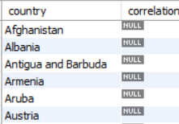
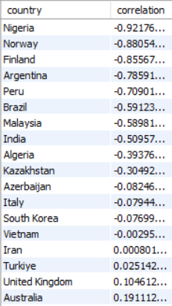
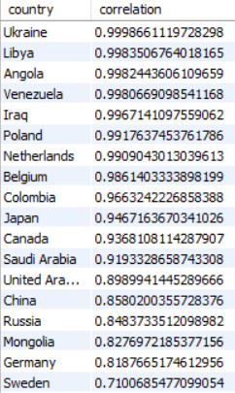
Data Analysis Questions
What is the correlation between GDP growth and energy production growth?
Positive Relationship:
GDP growth often aligns with Increase in energy production.
Economic expansion drives higher energy demand.
Negative Relationship:
Some countries show GDP growth without production increase.
These countries may rely on energy imports.
Negative or Low Growth Patterns
Occasional cases GDP increases but production decreases.
Indicates improved efficiency or structural changes in the
economy.

Slide 21
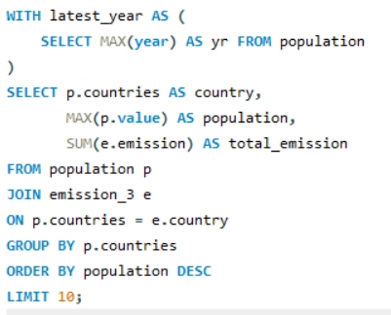
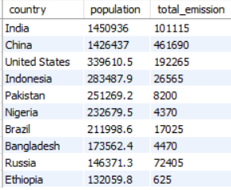
Data Analysis Questions
Global Comparisons
What are the top 10 countries by population and how do their emissions compare?
China, India dominate population.
USA high emissions despite lower population.
Highly populated countries contribute significantly to global emissions, but developed nations emit more per capita.

Slide 22
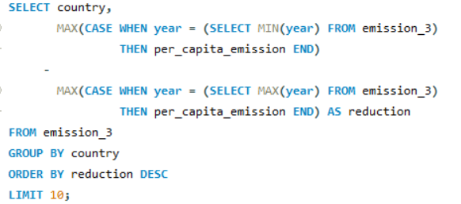



Data Analysis Questions
Which countries have improved (reduced) their per capita emissions the most over the last decade?
All countries show ‘0’ change in per capita emissions.
Emissions remain constant across years.
No country shows measurable progress in reducing emission.
The dataset indicates no change in per capita emissions
over time, suggesting either stable emission levels or lack
of variability in recorded data.
How to CONFIRM
You’ll see same values repeated

Slide 23


Data Analysis Questions
What is the global share (%) of emissions by country?
China contributes the largest share of global emissions (~32%), making it the dominant emitter.
The United States is the second-largest contributor (~13%),
significantly lower than China but still substantial.
India ranks third (~7%), indicating rapid industrial
growth and increasing energy demand.
Developed and industrialized nations dominate
emission share due to high energy consumption.
Many countries individually contribute less than 2%,
indicating unequal global emission distribution.
Global emissions are highly skewed, with few countries
responsible for the majority of environmental impact

Slide 24


Data Analysis Questions
What is the global average GDP, emission, and population by year?
Average global emissions show a steady increase from 2020 to 2023,
indicating rising environmental impact.
Global GDP also increases consistently over the years, reflecting
economic growth across countries.
Average population rises gradually, showing continuous global
population expansion.
Emissions are increasing alongside GDP, suggesting economic growth
is still dependent on energy consumption.
The simultaneous rise in GDP and emissions highlights a strong link
between economic activity and environmental impact.
Population growth contributes to higher energy demand, indirectly
influencing emission trends.
No decline in average emissions suggests that sustainability efforts
are not yet sufficient at a global level.
The trend indicates a need for balancing economic growth with environmental sustainability.

Slide 25
Conclusion
Global emissions, GDP, and population are all increasing together, showing a strong dependency between economic growth and energy consumption.
A small number of countries contribute the majority of emissions, highlighting unequal global environmental impact.
Per capita and ratio-based metrics reveal that efficiency varies significantly across countries, not just total output.
Most countries show little to no improvement in emission reduction, indicating slow progress toward sustainability goals.
The analysis highlights the urgent need to balance economic development with cleaner and more efficient energy usage.

Slide 26

THANK YOU

